Slide 1

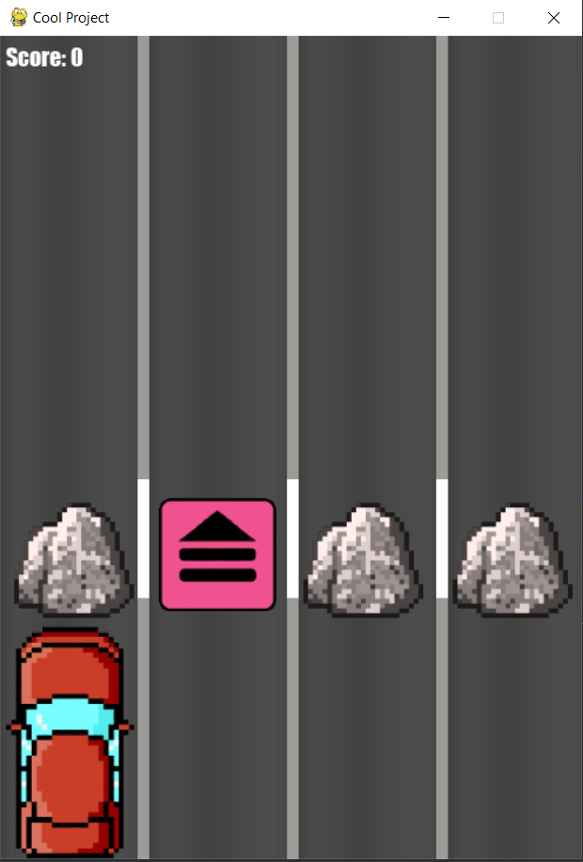
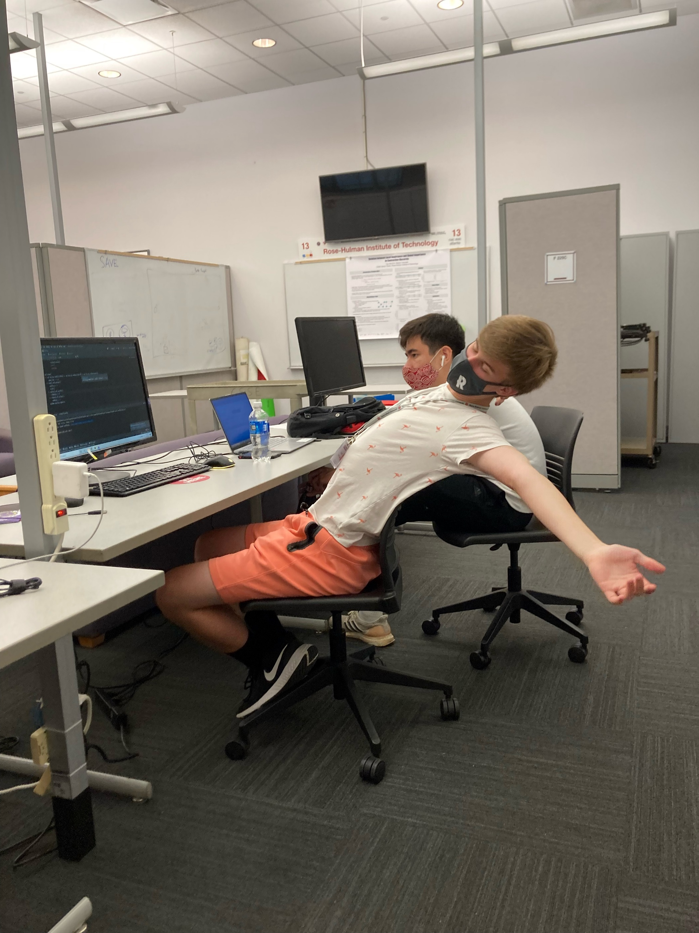
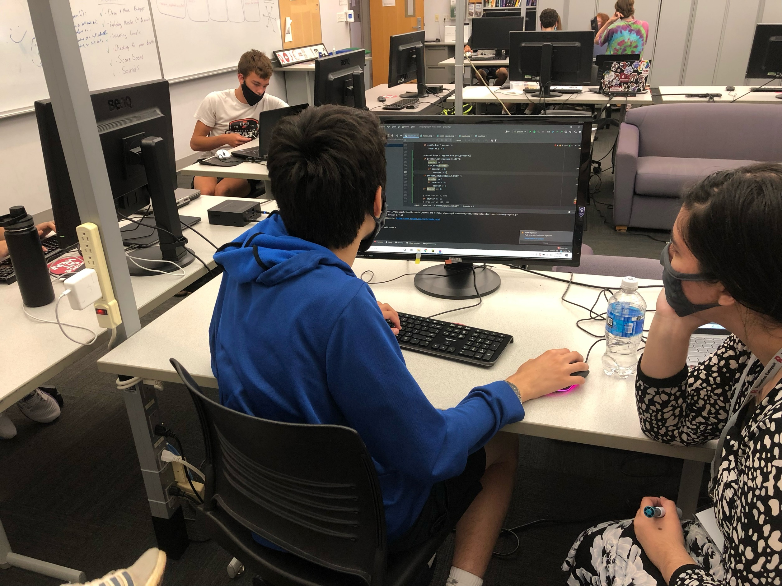
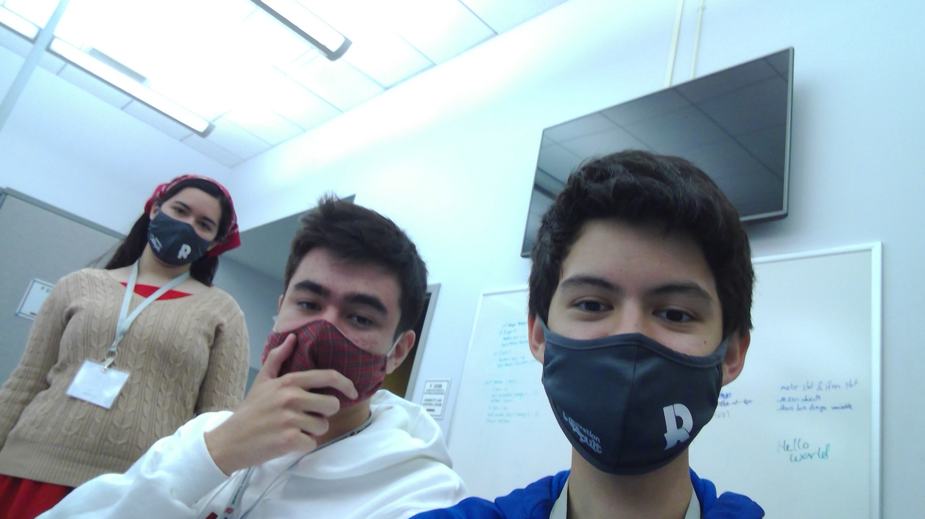
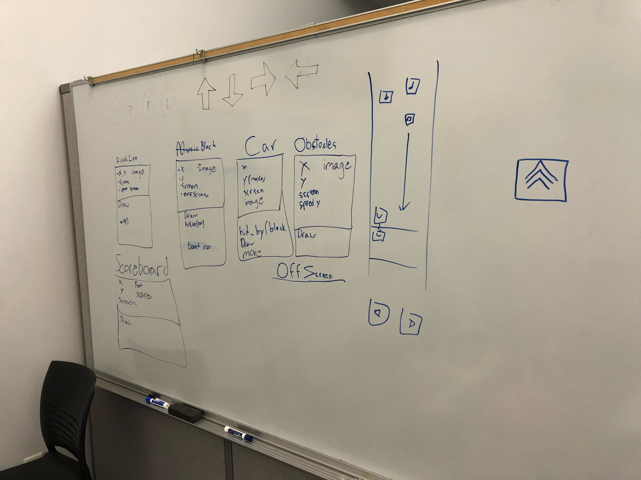
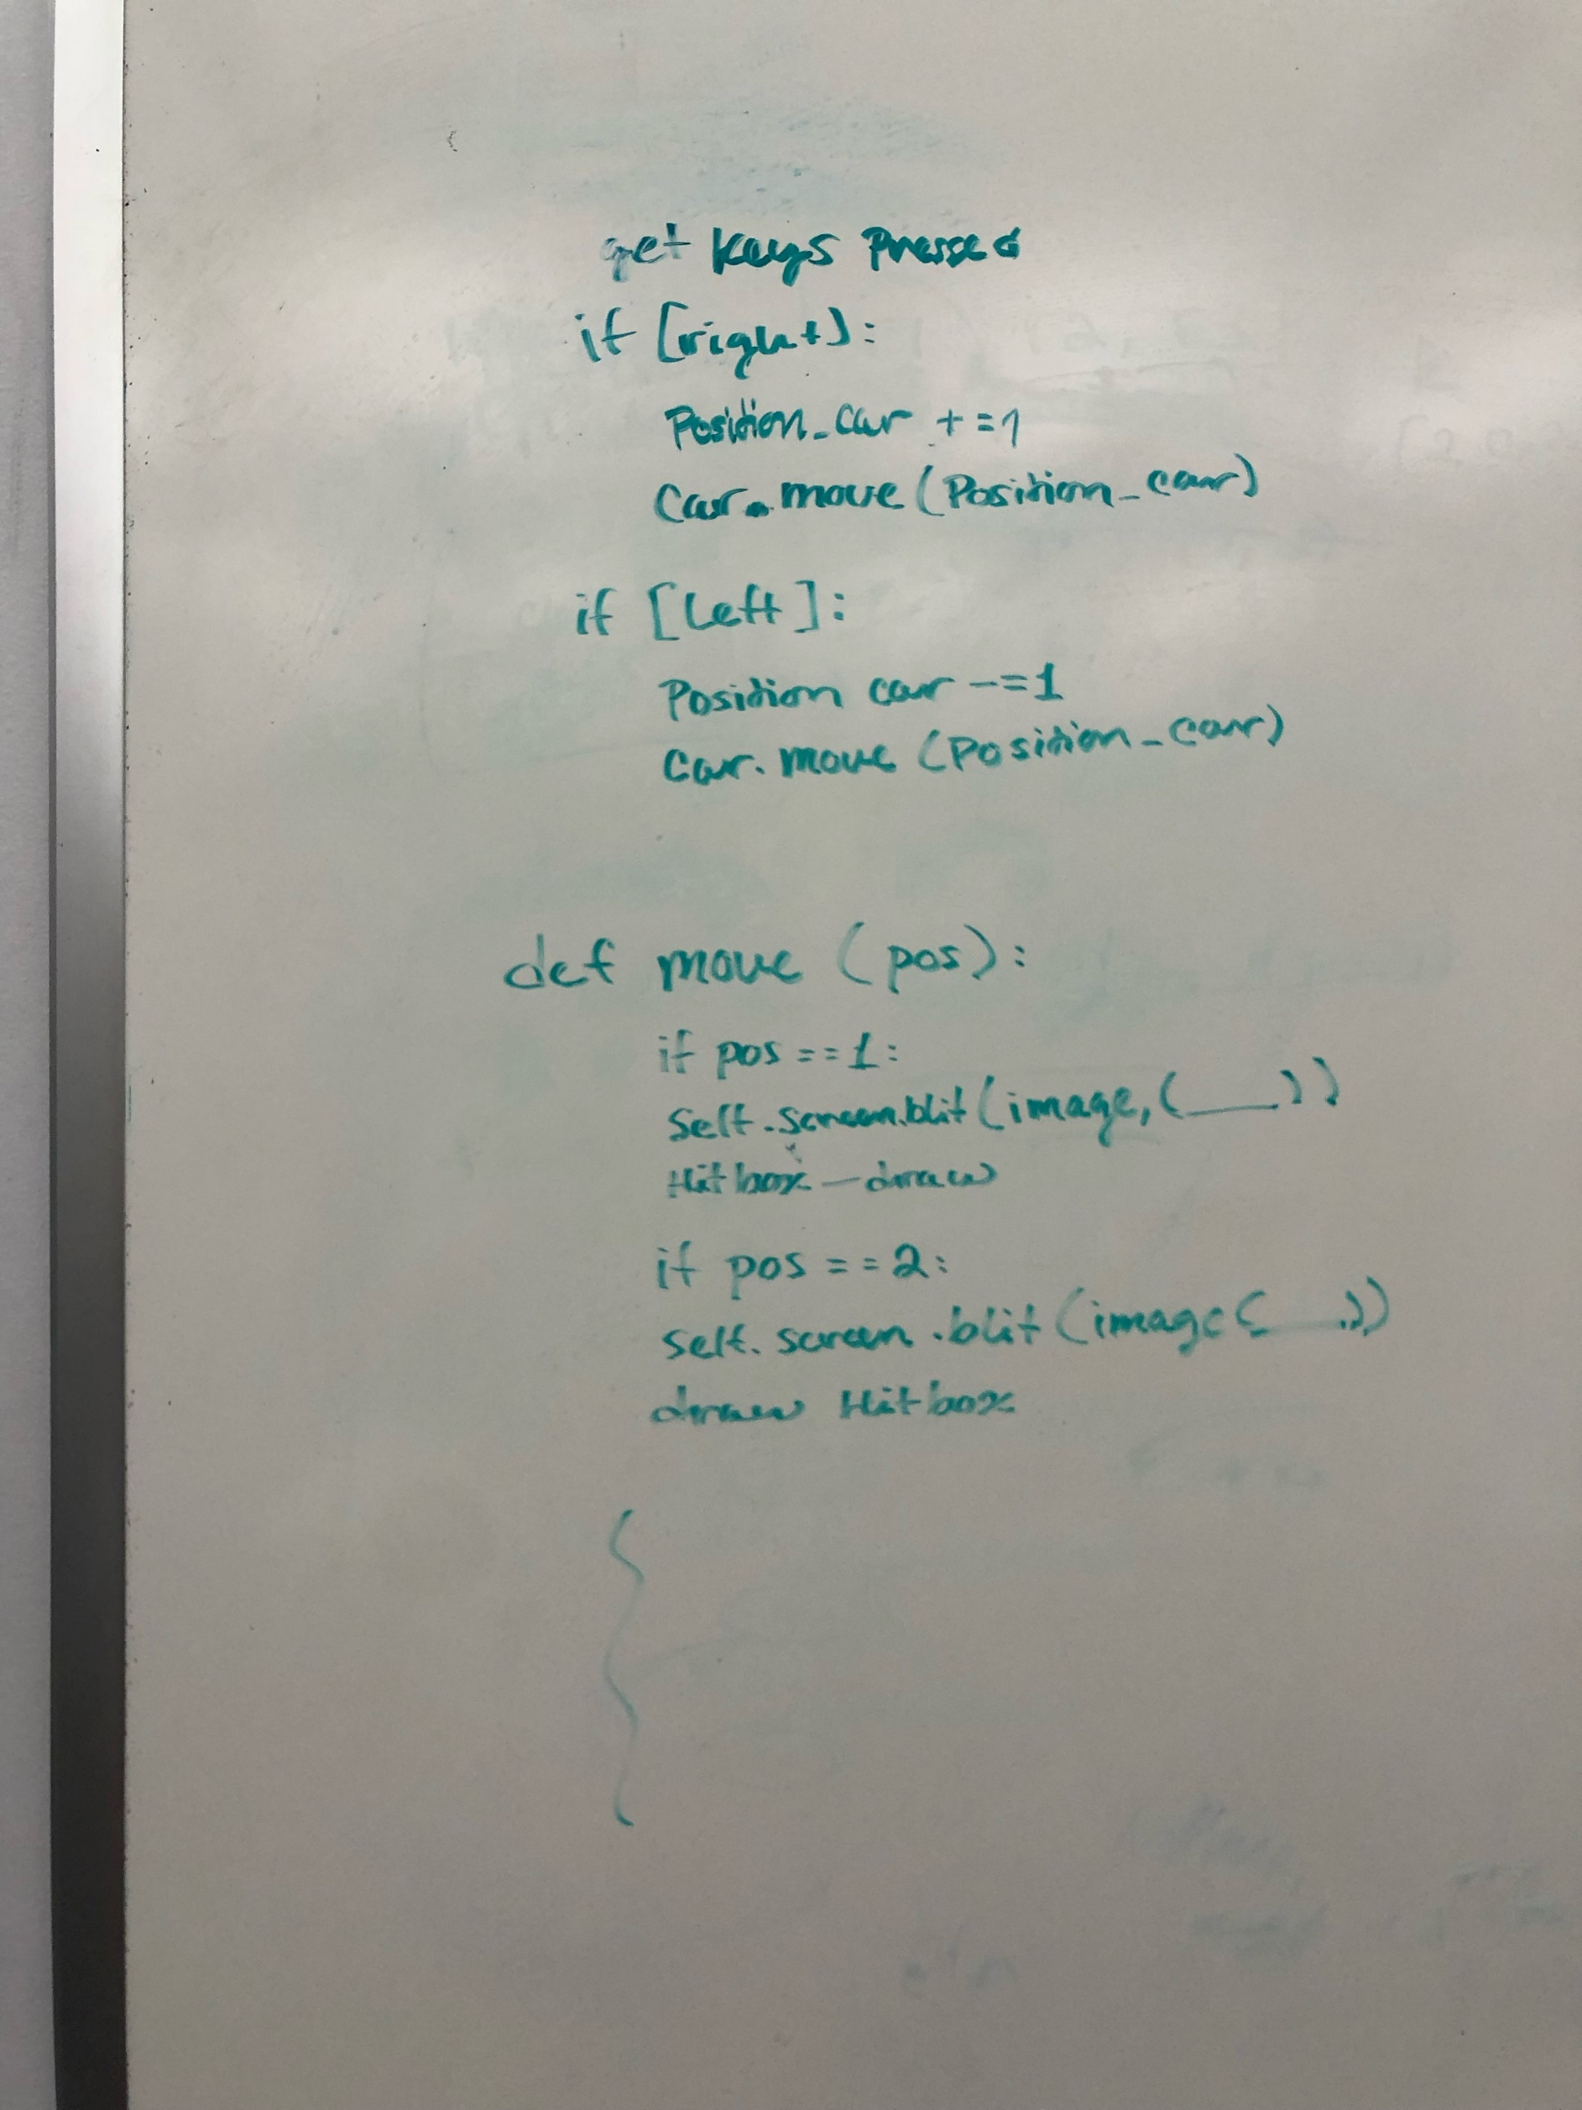
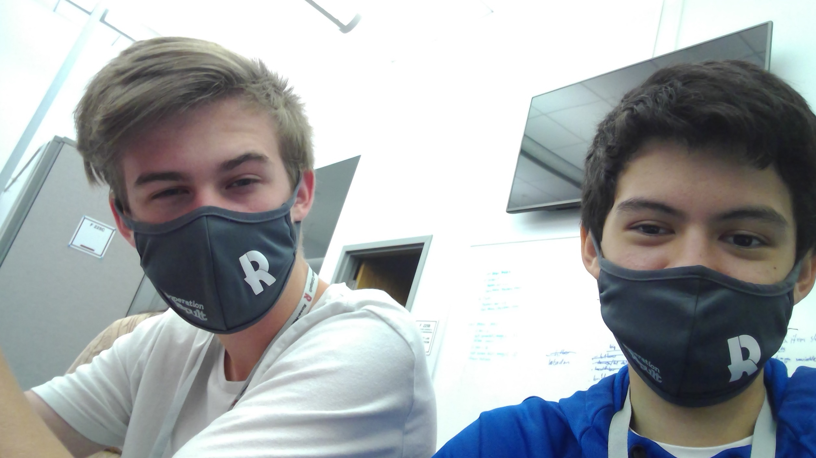
Team 10
Subway Surfers Rip-Off with cars
Operation Catapult 2021
By Harrison Carpenter, Noah Howard, and Caleb Bermack
Our game is a car/dodging game where you drive a car down the road and try to avoid rubble. You can also pick up boosters which will increase your speed over time, making the game harder as you pick up more.

